Slide 1


Business Report
HBFC Bank (Personal Loans)

Slide 2
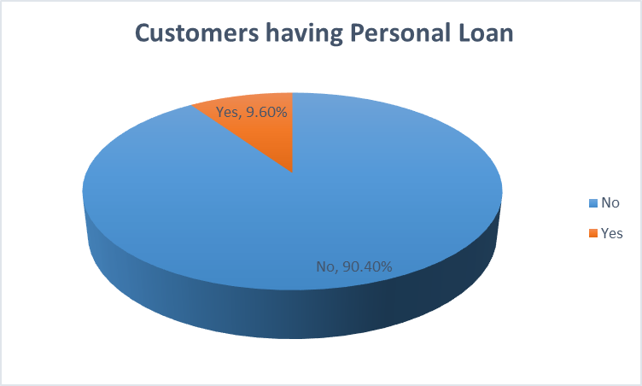
1. What percentage of the bank’s customers (according to the data) have availed Personal Loans?
Ans - It’s 9.60% of Bank customers have availed Personal loans
Approach : We can get the values in 2 methods. Which are from the dataset using filters and using pivot Table.
Best method is using pivot table.
Insert pivot table for the dataset.
Select “ID” field and drag into Values area as Count.
Right click on the values and select – show values as % of grand total.
Select the Table and insert – chart – pie chart (best model to represent comparison).

Slide 3
2. Generate a table with min, max, median & average for all numeric variables (age, experience, income, family members, CCAvg, Mortgage). What are your observations?
 | Minimum | Maximum | Median | Average
AGE | 23 | 67 | 45 | 45.3
INCOME | 8 | 224 | 64 | 73.8
FAMILY MEMBERS | 0 | 4 | 2 | 2.4
CCAvg | 0 | 10 | 1.5 | 1.9
MORTGAGE | 0 | 635 | 0 | 56.5
EXPERIENCE | 0 | 43 | 20 | 20.1
Ans: Used In-built functions of Minimum, Maximum, Median and Average.
=MIN(Number1,…….Number N) => Gives minimum value in the Range.
=MAX(Number1,…….Number N) => Gives maximum value in the Range.
=MEDIAN(Number1,…….Number N) => Gives middle most value in the Range.
=AVERAGE(Number1,…….Number N) => Gives Average value of the Range.
Observations: From the above Table
Average age of the Customer is 45.
Minimum Annual Income of customer is 8000$.
Maximum Family size of Customers is 4.
Least Experience a customer having is 0.
Note: Always sort the data while finding the Median

Slide 4
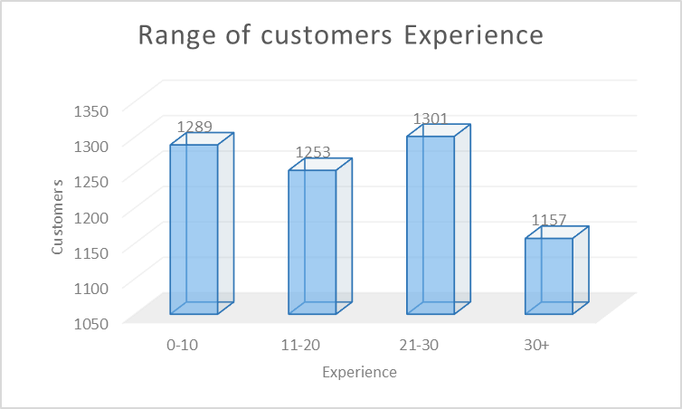
3. Create a new categorical variable for Experience using 4 categories – 0 to 10 years 11 to 20 years 21 to 30 years and 30+ years. Plot a bar graph for this new categorical variable
Approach:
We have a numerical data of all customer ages, in-order to change them into categorical, we need to divide them into ranges and assign every numerical data a range to represent.
By using “IF” condition we can derive ranges of respective Numerical data.
=IF(C2<=10,"0-10",IF(C2<=20,"11-20",IF(C2<=30,"21-30","30+")))
By using above condition we can derive every data its respected range and assign it.
Insert pivot chart and take new experience categorical and customers as count, we can plot a bar graph out of it.

Slide 5
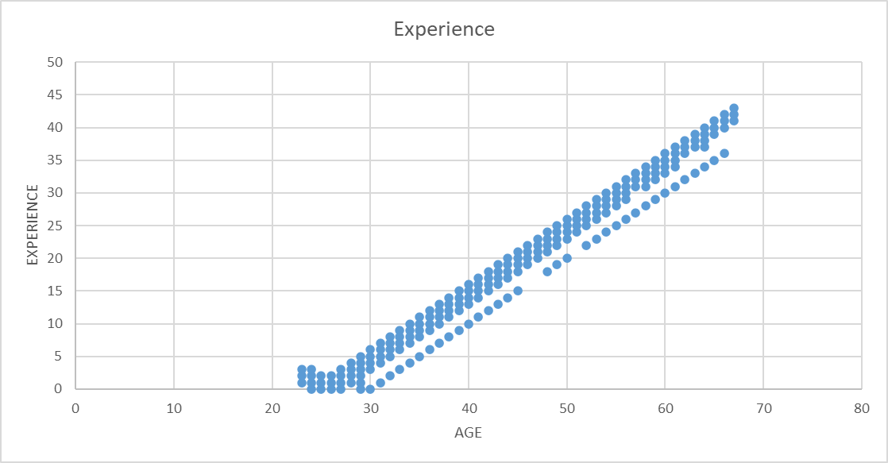
4. Create a scatter plot of the Age and the Experience variable. What do you observe?
Observations: We have Customers whose Ages are from 23 to 67.
The observation of the plots is Linear.
With Increased Age the Experience Increases too.

Slide 6
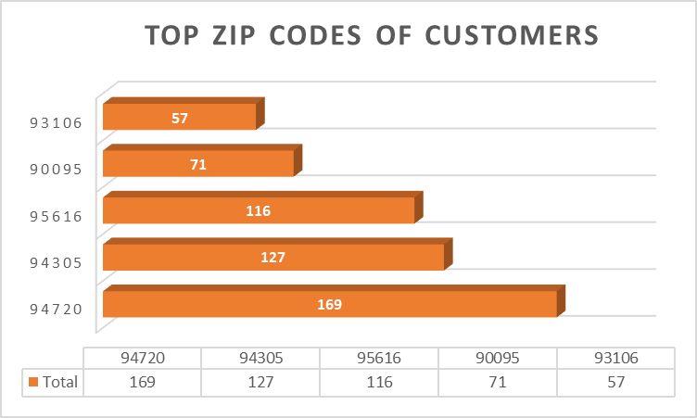
5. What are the top 3 areas (ZIP Codes) where the bank’s customers are located?
Ans: Top 3 ZIP codes where the customers are from are
ZIP- 94720 with 169 customers.
ZIP- 94305 with 127 customers.
ZIP- 95616 with 116 customers.
Approach: Insert a pivot table for the data add ZIP in rows filed and ID in values field as count. We have the count of customers for every ZIP codes.
Click on the filter option for the ZIP – values filters – Top 10 (we can adjust the top values in the option, I went with top 5).
Insert chart for the table and try different layouts.

Slide 7
6. How many customers have a combination of Fixed Deposits and Credit Cards but not Personal Loan?
Ans: 147
Now, there are two ways we can get the result.
Process 1
Insert a pivot table for the Data.
Drag Fixed Deposits, Credit cards and Personal Loans into filter fields.
Drag ID into rows.
Filter Fixed Deposits and Credit cards as ‘Yes’ and Personal Loan as ‘No’.
We get the count of ID with above filter
Process 2
We can create a column with IF condition and assign values to get the count.
created new column FC&CC/PL
ID's which have both FD and CC as Yes and PL as No gets FD else NIL.
Compared to values and both are same.

Slide 8
7. What is the median income of the customers who have availed personal loans and compare it with the median income of those customers who have not availed personal loans? What do you infer?
Ans: Used In-built function
=MEDIAN((Number1,…….Number N) => Gives middle most value in the Range.
Median income of the customers who have availed personal loans = 143
Median income of those customers who have not availed personal loans = 59
When compared we can observe that income of customers who availed personal loan is high irrespective of the few head count.
Inference: Having a High Income is helpful for purchasing a Personal loan.

Slide 9
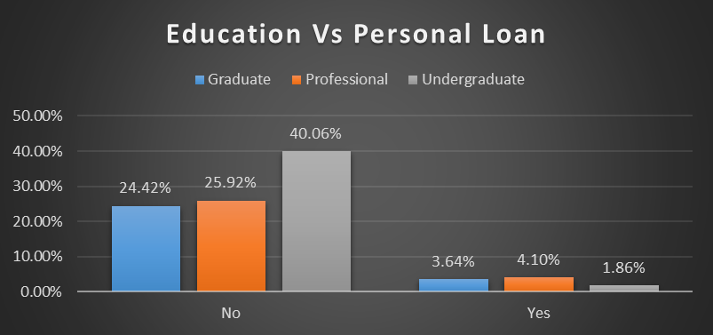
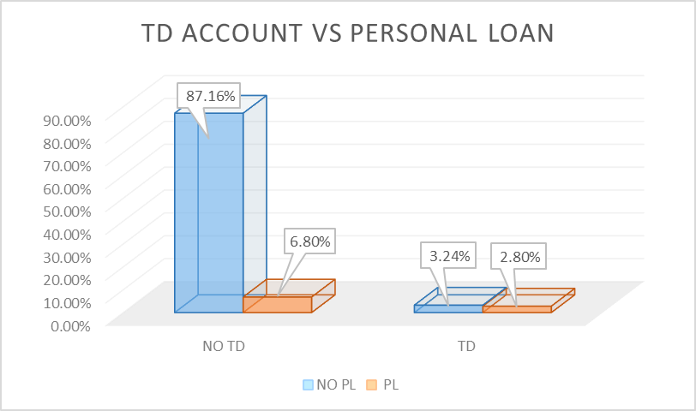
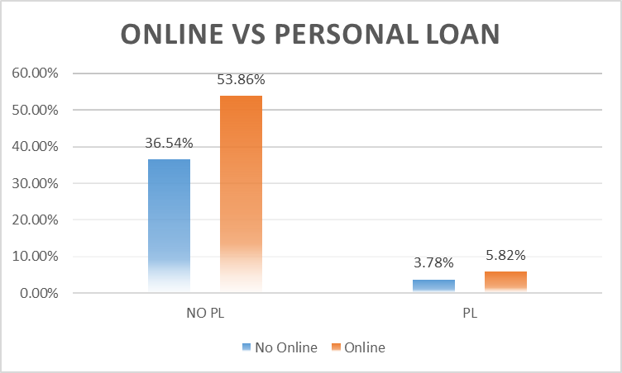
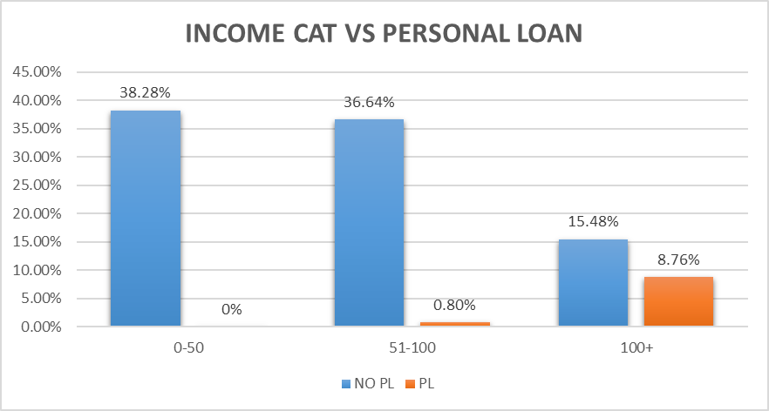
8. Create 4 separate Pivot Tables. Summarise your data by percentages. Education vs Personal Loan TD Account vs Personal Loan Online vs Personal Loan Income_Category vs Personal Loan.

Slide 10
9. Analyse the Pivot tables created in the previous question and state any anomaly that you observe. Which categorical variables appear most important for your further study if you want to analyse which customers are most likely to take personal loans and why?
Ans: From the Tables created Online vs Personal loan seems to be an anomaly, it does not seems to effect the Personal loan trend.
On the other hand Income tax_category seems to have higher effect on the personal loan purchasing trend, that said customers with high income have high probability of purchasing Personal loan.

Slide 11

10. In the last campaign, bank reached out to 5000 customers out of which 480 customers accepted the personal loan offer. The bank incurred a huge cost in running a marketing campaign to reach out to so many customers. This is where you as a strategic business consultant step in. You are tasked to optimise the cost of this campaign by identifying the correct target base (without significant reduction in number of acceptance of offers). The bank can then send Personal Loan offers to these target customers who have a higher chance of accepting the offer. Based on your analysis, what strategy would you suggest to the management of HBFC bank?
DETAILED EXPLANATION IS PROVIDED IN NEXT SLIDES

Slide 12

From the data of customer who picked Personal loan.
Observations:
1. Filtered the customers who picked PL and obsereved a common trend in the customers from mortgage section i.e,.
Collected all the mortgage values and removed the duplicates, Found that the minimum mortgage that customer who picked PL is 0.
However, The 2nd minimum Mortgage of from the PL availed customers is 75.Which is greater than the average mortgage of total customers.(check answer from Q.No2)
2. From above observation their is an another trend that poped out is.
All the customers who have 0 mortgage have a support of income which encouraged them to avail PL.
All the customers who have 0 mortgage only belongs to 2 Income categories which are ‘50-100 & 100+'.
3. Their is a high probability of selling PL if bank reaches out to those customers who belong to -
priority 1- Customers whose Income sits in any of 50-100 & 100+ category and having mortgage more than 60.
priority 2- Customers whose Income sits in any of 50-100 & 100+ category . Attract these category customers with 0 mortgage Promotion.

Slide 13
4. From the data of customers who purchased PL , Professionals are more likely to take up PL when compared to Graduates and Undergrads. Which further enhances the priority.
priority 1- Customers whose Income sits in any of 50-100 & 100+ category and having mortgage more than 60.
priority 1 customers - Professional
priority 2 customers - Graduates
Priority 3 customers - Undergraduates
priority 2- Customers whose Income sits in any of 50-100 & 100+ category and having mortgage less than average motgage (57).Attract these category customers with 0 mortgage Promotion.
priority 1 customers - Professional
priority 2 customers - Graduates
Priority 3 customers - Undergraduates
Personal Loan - Yes
Row Labels Count of Education
Graduate 37.92%
Professional 42.71%
Undergraduate 19.38%
Grand Total 100.00%

Slide 14
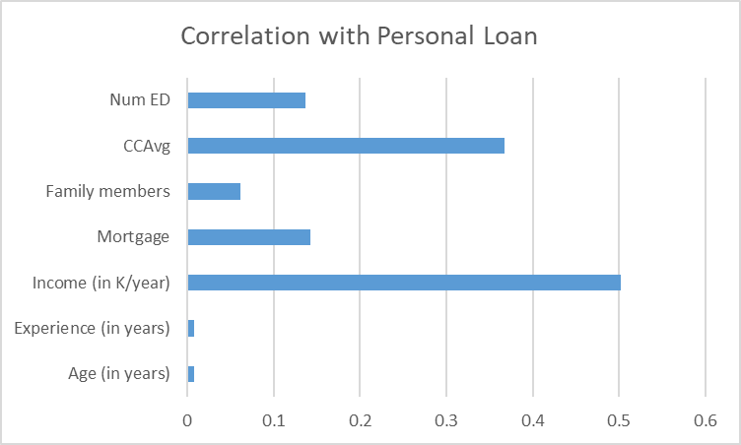
5. On further inspecting performed a correlation with Personal Loan by converting it into numerical values.
6. We covered priority based on Income and Education after correlation, Targeting customers with average Ccavg of 1.9 and more would be fruitful.

Slide 15
Thank You

